Slide 1

Approximation Ratios
An approximation produces a solution T
  T is a k-approximation to the optimal solution OPT if c(T)/c(OPT) < k (assuming a min. prob.; a maximization approximation would be the reverse)
NP-Completeness
1

Slide 2
Polynomial-Time Approximation Schemes
A problem L has a polynomial-time approximation scheme (PTAS) if it has a polynomial-time (1+ε)-approximation algorithm, for any fixed ε >0 (this value can appear in the running time).
Subset Sum has a PTAS.
NP-Completeness

Slide 3

Vertex Cover
A vertex cover of graph G=(V,E) is a subset W of V, such that, for every (a,b) in E, a is in W or b is in W.
OPT-VERTEX-COVER: Given an graph G, find a vertex cover of G with smallest size.
OPT-VERTEX-COVER is NP-hard.
NP-Completeness

Slide 4
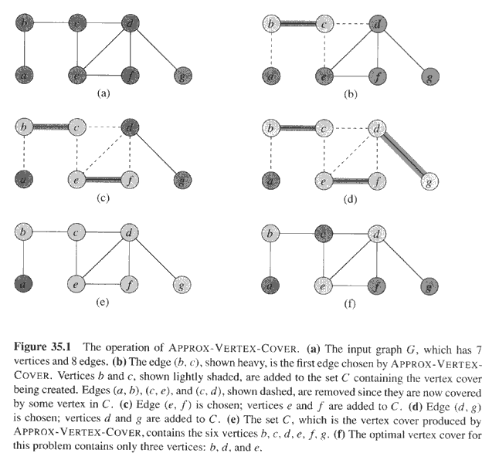
Copyright © The McGraw-Hill Companies, Inc. Permission required for reproduction or display.
NP-Completeness

Slide 5
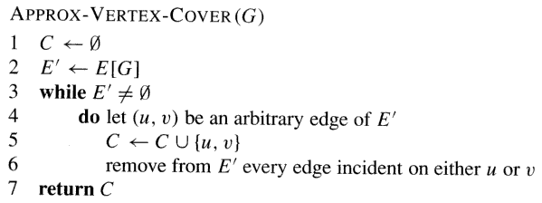
Copyright © The McGraw-Hill Companies, Inc. Permission required for reproduction or display.
NP-Completeness

Slide 6
Problem
Give an approximation solution using the 2-factor algorithm.
What is the optimal solution?
What is your ratio? App./opt.
NP-Completeness

